Slide 1
San Francisco Employee Data Prediction
Group 285
Utkarsha Vidhale
Vaidehi Rathkanthiwar
Prashant Raina

Slide 2
Introduction
One of the most important aspects of running your business is keeping your employees happy by offering them high-quality employee benefits and compensation.
So, there must be some solution in which company can know in advance about the compensation structure based on job profile and organization.
Employers can use this model to imbibe some knowledge regarding the compensation factors and employees can use it to decide which job profiles are receiving maximum benefits

Slide 3
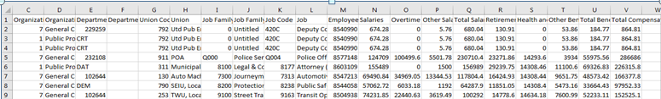
Dataset
Our dataset has 1 file with 835308 instances and 22 columns.
Predicting Salary
Predicting Total Compensation

Slide 4
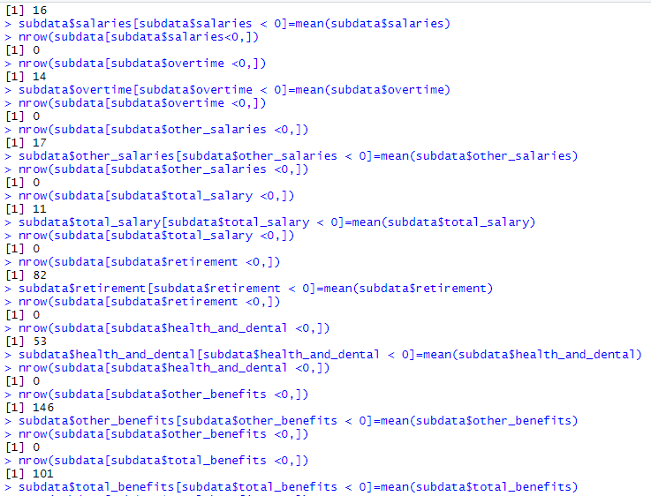
Preprocessing
Checking negative values
Preprocessing | Column Names
Negative Values | Salaries, Overtime, Other Salaries, Retirement, Other Benefits
Blanks, Missing Values | Department Code, Union
Removal of unnecessary Columns | Employee Identifier Job family code Union code Organization group code Job code

Slide 5
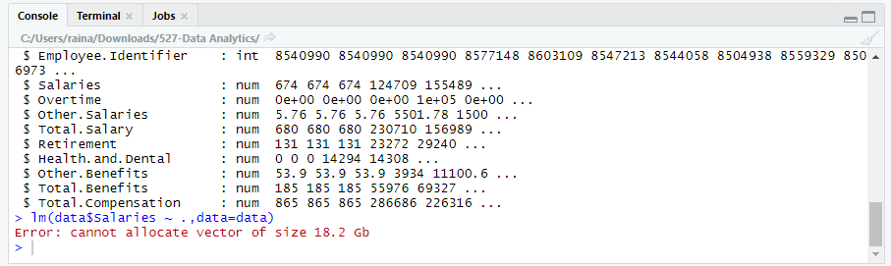
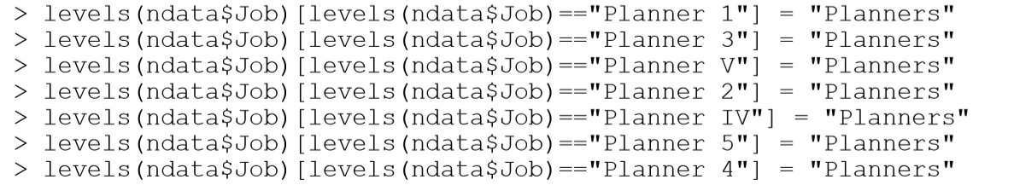
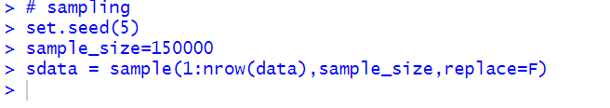
Issues while loading the dataset
Solutions :
A) Grouping (Job, Job Family, Union)
B) Sampling(150000)

Slide 6
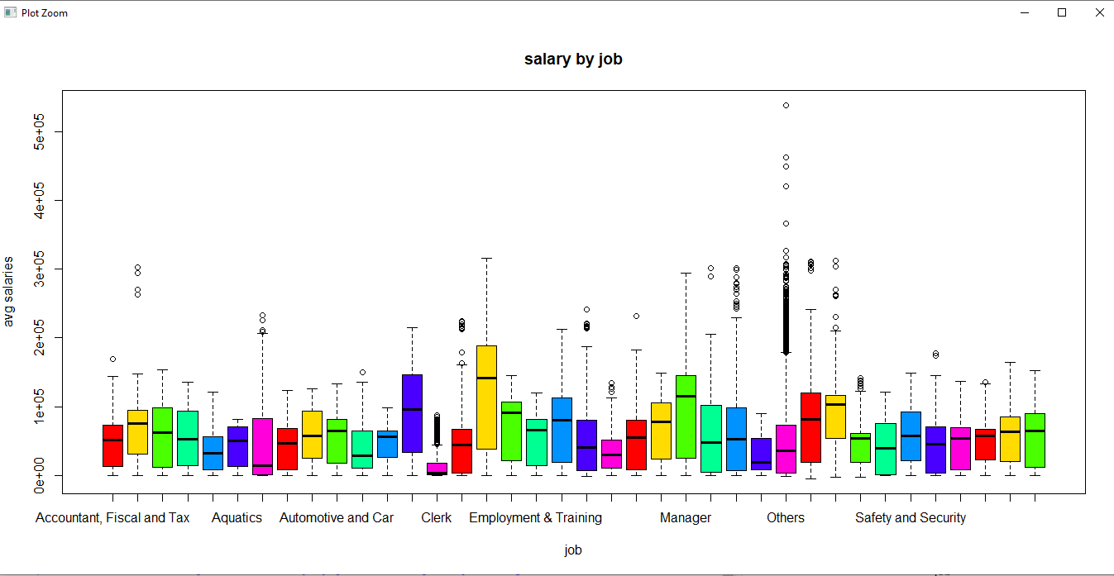
ANOVA and Hypothesis Testing for Job
Boxplot for Salaries vs Job

Slide 7
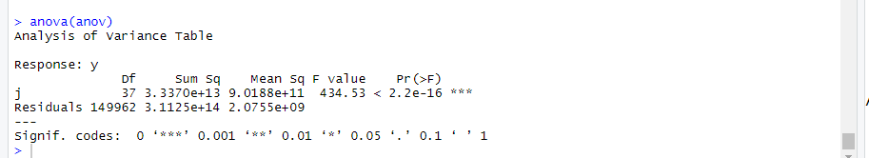
ANOVA and Hypothesis Testing for Job
Null hypothesis : All the average salaries for jobs are equal
Alternate hypothesis : Not all the average salaries for jobs are equal
At 95% confidence level, p-value is less than 0.05, we can reject null- hypothesis. Hence, the avg salaries are not equal for all jobs.

Slide 8
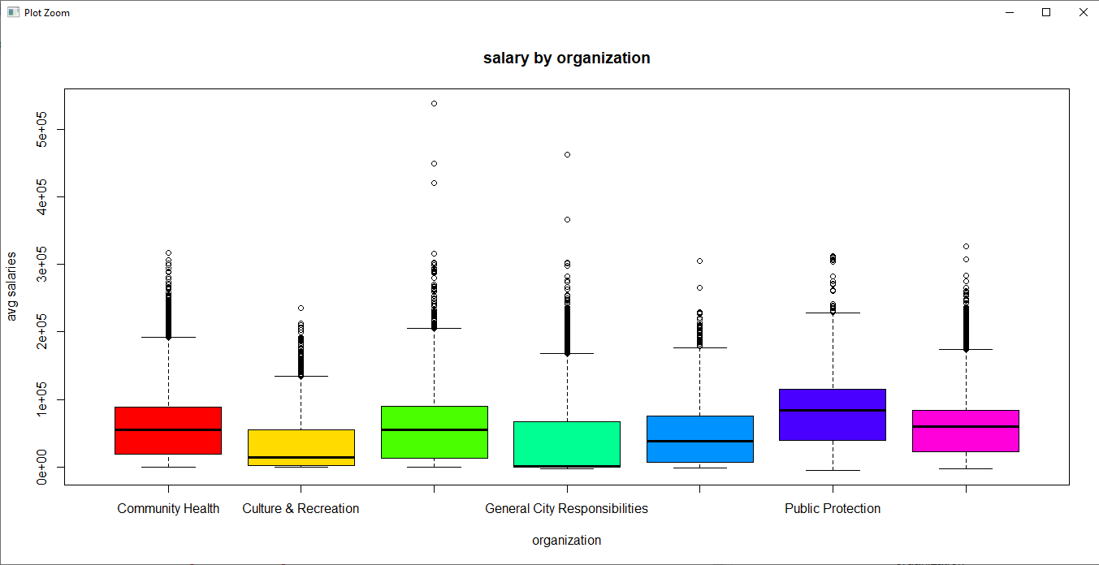
Mean comparison for Organization_group
Boxplot for Salaries vs Organization_group

Slide 9
Mean comparison for Organization_group
We can compare means directly from the boxplots, as variation is almost same in all the cases.
Public Protection group has the maximum average salaries.

Slide 10
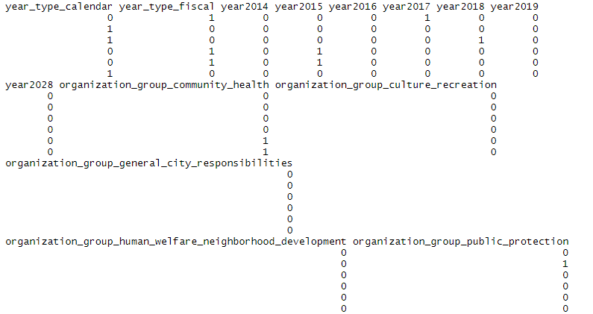
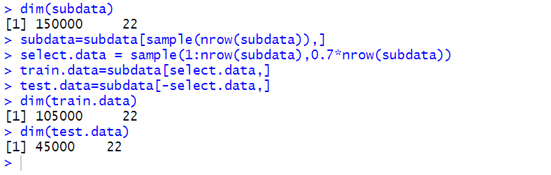
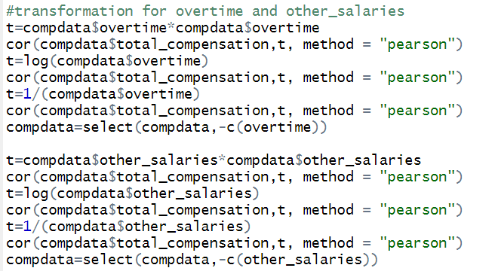
Building Predictive Models:
1. Dummy variables
2. Hold Out Evaluation
Predicting Total Compensation of each employee based on other factors.
3. Weak Co relations and Transformation

Slide 11

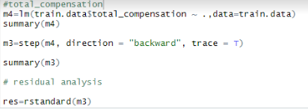
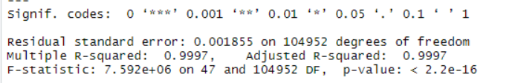
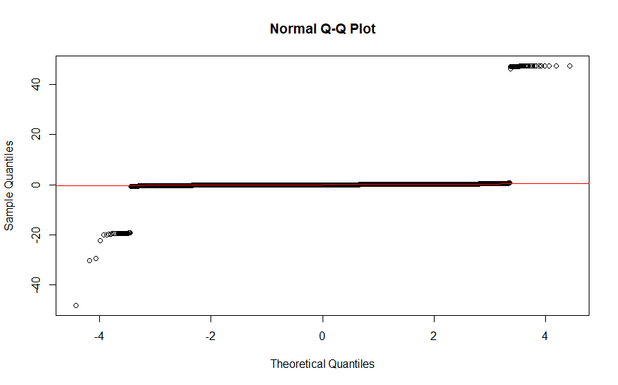
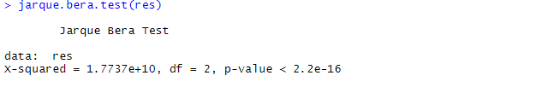
Predicting Total Compensation
Search Algorithm - Backward Elimination,
Feature Selection Criteria - AIC
Model 1
Residual Analysis
Normality test
JarqueBera Test

Slide 12
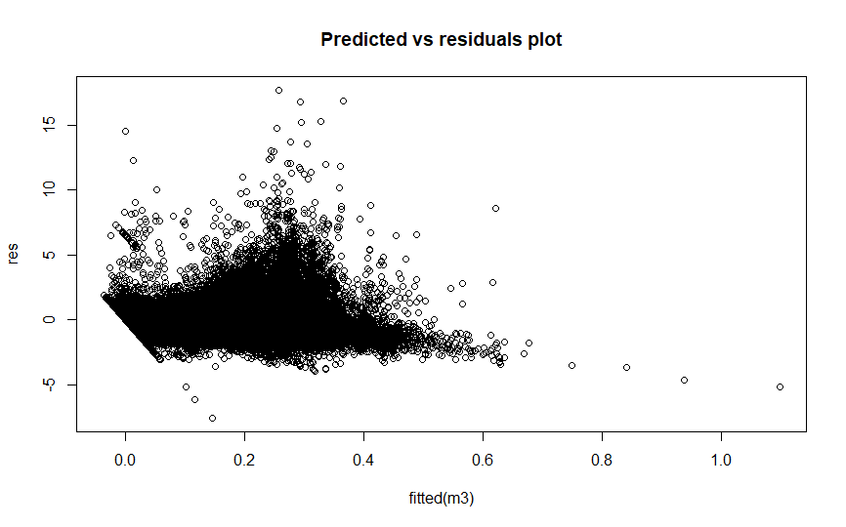
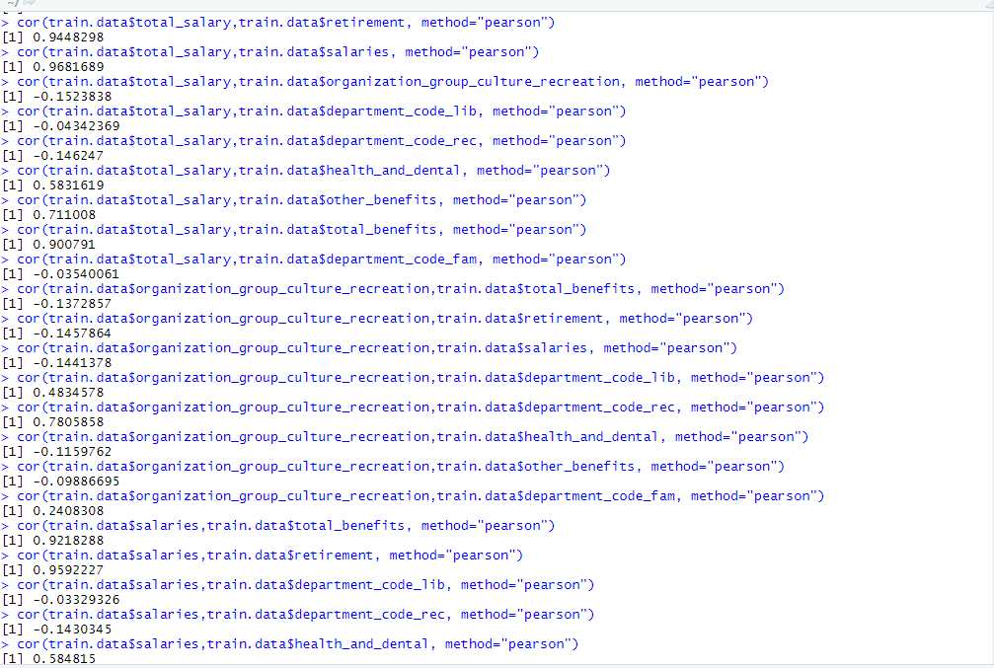
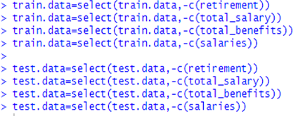
Predicting Total Compensation
Search Algorithm - Backward Elimination,
Feature Selection Criteria - AIC
Residual Plot (constant variance)
Checking multi co linearity using VIF
Removal of columns

Slide 13
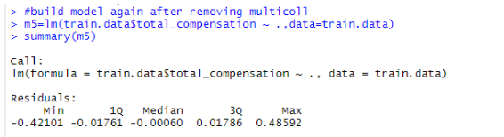

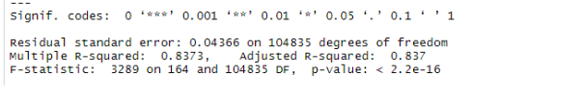
Predicting Total Compensation
Search Algorithm - Backward Elimination,
Feature Selection Criteria - AIC
Model After resolving multi-collinearity

Slide 14
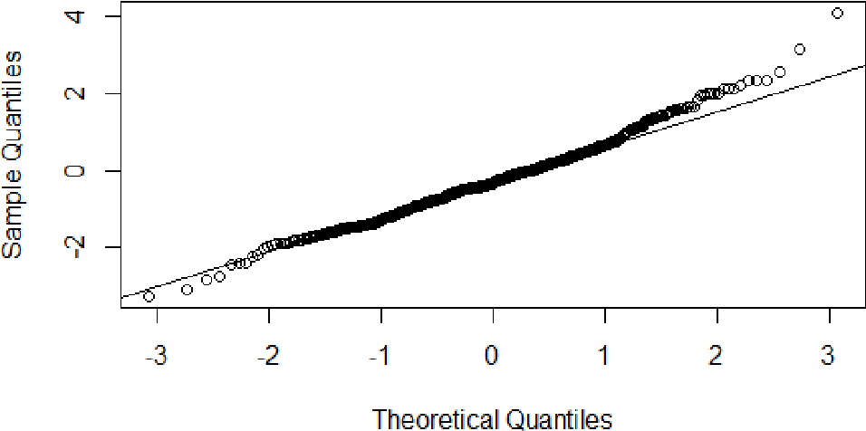
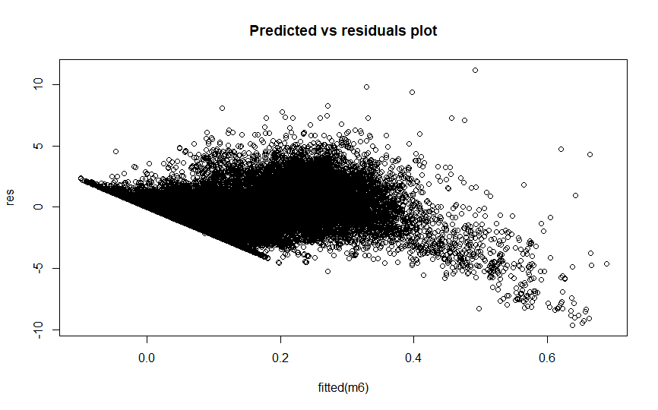
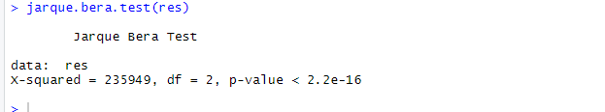
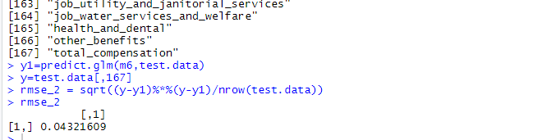
Predicting Total Compensation
(Residual Analysis)
Search Algorithm - Backward Elimination,
Feature Selection Criteria - AIC
Normality test
Residual Plot (constant variance)
JarqueBera Test
RMSE

Slide 15

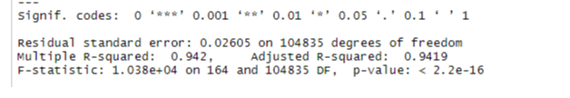
Predicting Total Compensation
Search Algorithm - Forward Selection,
Feature Selection Criteria - AIC
Similarly we built the final model with forward selection using AIC whose specifications are as below:
Improved model
Ajd-R2 = 0.942

Slide 16
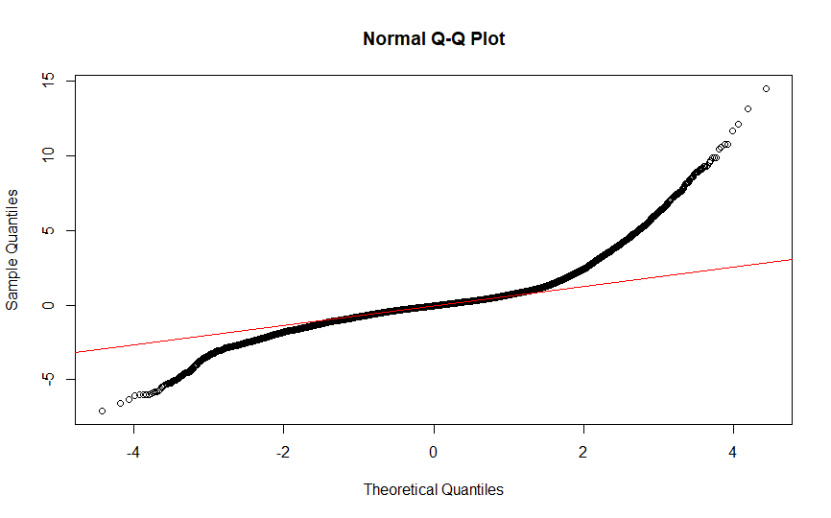
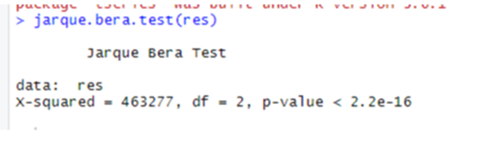
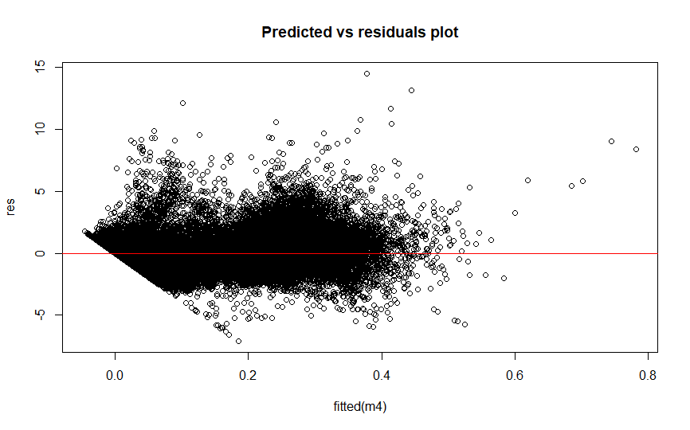
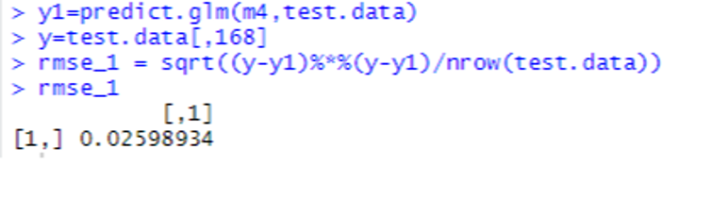
Predicting Total Compensation
(Residual Analysis)
Search Algorithm - Forward Selection,
Feature Selection Criteria - AIC
Normality test
JarqueBera Test
Residual plot (Constant Variance)
RMSE

Slide 17
Best Model for Total Compensation (Forward Selection And Backward Elimination Comparison )
Predicting Total Compensation
Measures
ADJ R2
RMSE
Backward Elimination | Forward Selection
0.837 | 0.9419
0.0431 | 0.0259
Here, we can see RMSE is better for model with Forward Selection search algorithm. Hence it will be more accurate.

Slide 18
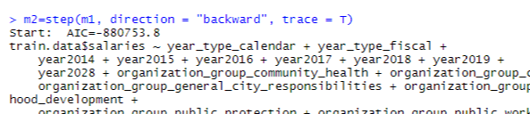

Predicting Salary
Search Algorithm - Backward Elimination,
Feature Selection Criteria - AIC
Like Total Compensation, we built the model for Salary and following are the different metrics we got.
Improved model
Ajd-R2 = 0.9958

Slide 19
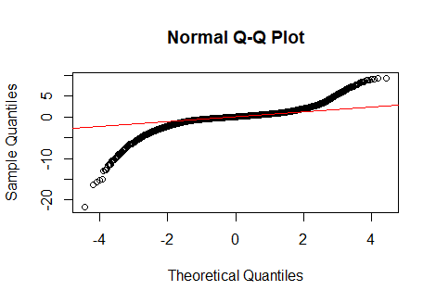
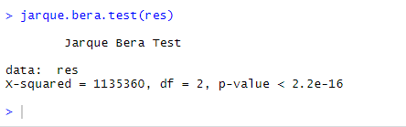
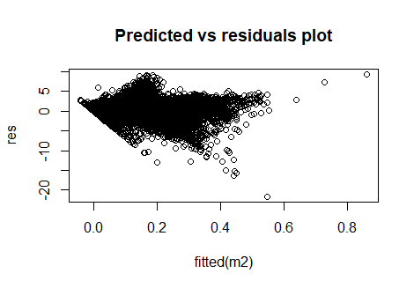
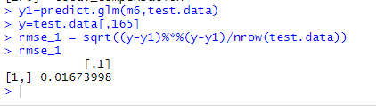
Predicting Salary
(Residual Analysis)
Search Algorithm – Backward Elimination,
Feature Selection Criteria - AIC
Normality test
JarqueBera Test
Residual plot (Constant Variance)
RMSE

Slide 20
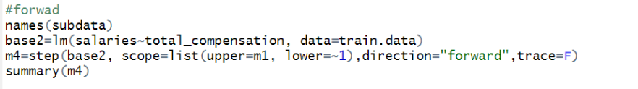
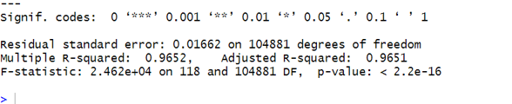
Predicting Salary
Search Algorithm - Forward Selection,
Feature Selection Criteria - AIC
Similarly we built the final model with forward selection whose specifications are as below:
Improved model
Ajd-R2 = 0.9651

Slide 21
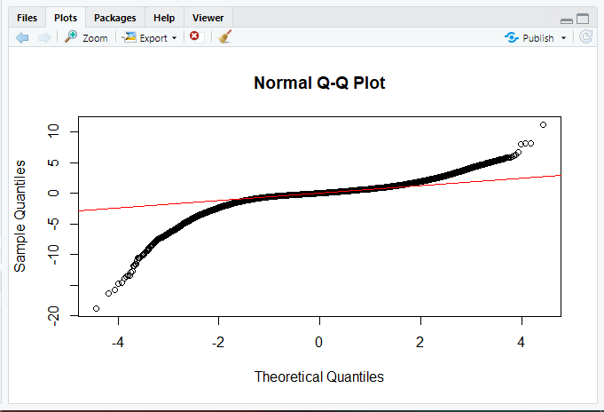
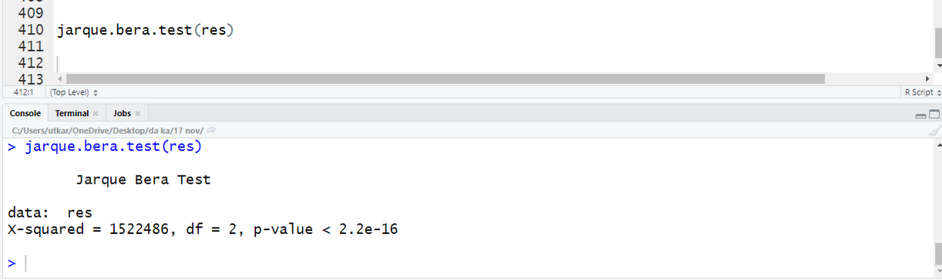
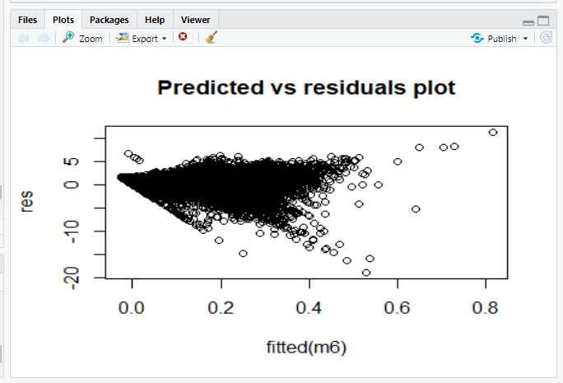
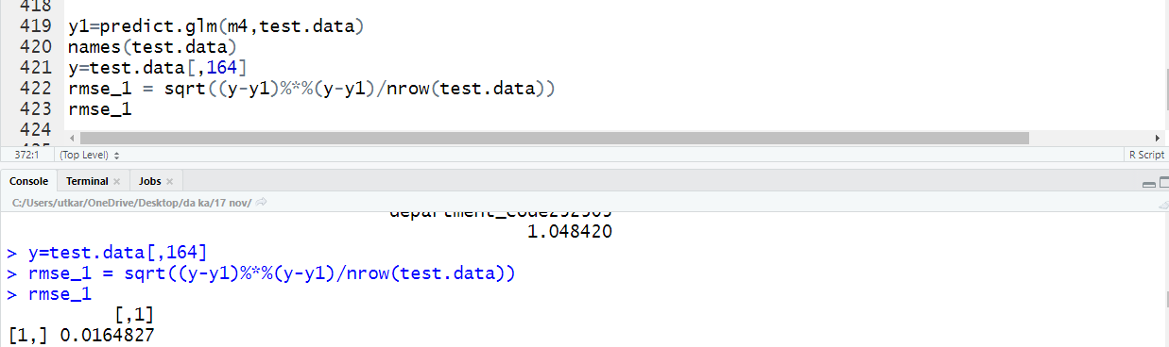
Predicting Salary
(Residual Analysis)
Search Algorithm – Forward Selection,
Feature Selection Criteria - AIC
Normality test
JarqueBera Test
Residual plot (Constant Variance)
RMSE

Slide 22
Predicting Salary
Best Model for Predicting Salary (Forward Selection And Backward Elimination Comparison )
Measures
ADJ R2
RMSE
Backward Elimination | Forward Selection
0.9658 | 0.9651
0.0167 | 0.0164
Here, we can see RMSE is slightly better for model with Forward Elimination search algorithm. Hence it will be more accurate.

Slide 23
Limitations And Future Scope
Grouping of the job profiles in a better way in order to provide best association.
Individual parameter test for each job profile in ANOVA testing in order to build better prediction model.
Treatment of influential points; due to large dataset, influence measures wasn’t giving proper results for influence points, so we can do it better on proper systems with enhanced specifications.
Employees can use the predictive model to imply better strategies in terms of better job search which can provide better compensation and salary.
Similarly, Employers can decide what compensation and salary should be given to the job seeker based on job and other factors in order to optimize their financial status.

